Slide 1
Functions
In everyday language the word “function” has at least two separate meanings I can think of:
A. The purpose of something, as in
“The function of a teacher is to impart knowledge.”
B. When the value of some item
somehow determines uniquely the value of
some other item, as in
“Your (alphabetized) last name determines
uniquely your position on the (numbered)
attendance sheet”
(we say that the position is a function of the last name)
or as in

Slide 2


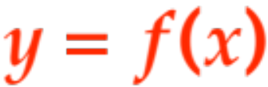
“the radius of a sphere determines uniquely
its volume”
(we say the volume is a function of the radius.)
In this course we will deal exclusively with the second interpretation:
the value of some item (usually called )
somehow determines uniquely
the value of some other item (usually called )
(we say is a function of and write )
With the wisdom of more than one century of thought
we give the definition:
Definition. A function is the following three things:

Slide 3


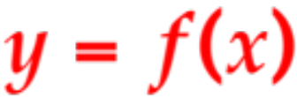

A set D of items, called the domain (the ‘s)
A set R of items, called the range (the ‘s)
A rule or procedure f that for every given item in D determines uniquely an item in R.
We write or, more pictorially
In this class we will eventually restrict ourselves to very specific domains and ranges, but, in a free country, as long as the three items above obtain we have a function. Here are four distinct ways (actually fairly exhaustive) that a function can arise in real life (figure out what the domain, range and rule are in each case)

Slide 4
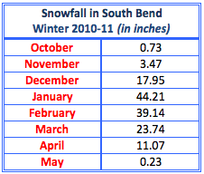
A table:

Slide 5
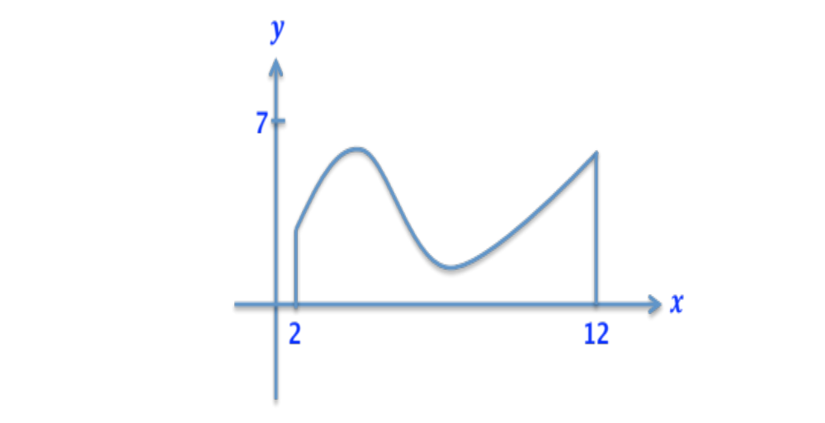
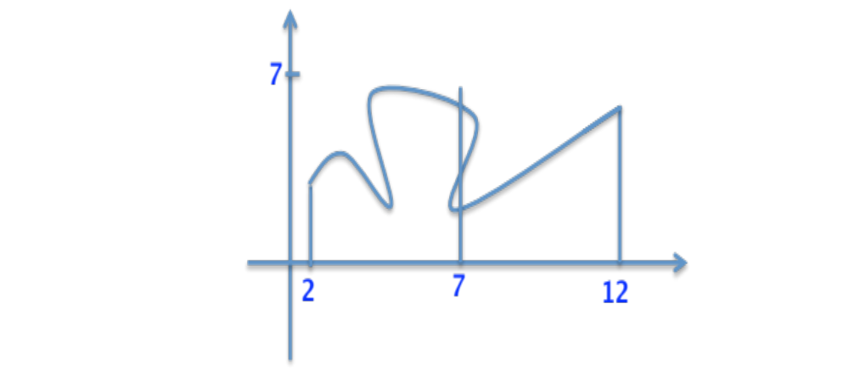
A graph
Careful!, not all squiggles are functions!, e.g
what is f(7) ?
See p. 15 of text. They
describe the
vertical line test.

Slide 6
A verbal description
The cost of parking in a certain parking garage in Chicago is $15.00 for the first hour plus $5.00 for each additional half-hour or portion thereof.
(This means that if you are late, one minute can cost you $5.00 !)
Fun question: I get to the garage at 10:43 am, park my car and retrieve it at 7:12 pm.
How much do I pay?

Slide 7
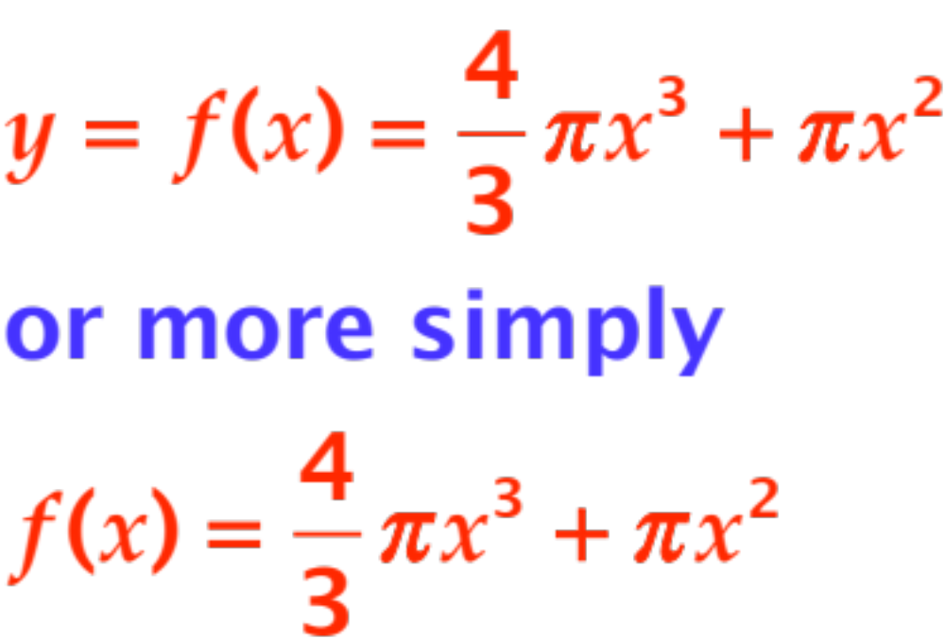
(The most common) An explicit formula
Fun question: This is the volume of something, of what?

Slide 8

In this class all functions will be of the type
where D is a set of real numbers, R is a set of real numbers, and the function may be a graph, a formula or both.
In fact, with few exceptions both D and R will be the entire set of real numbers, and we will spend a fair amount of time learning how to graph functions in cartesian coordinates and, conversely, to infer properties of a function from its graph.

Slide 9
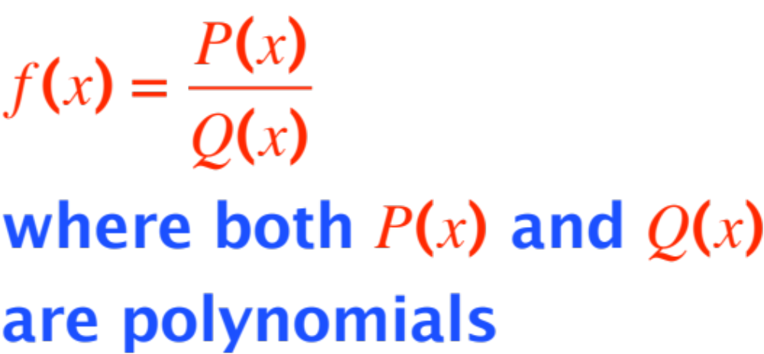
The functions we will study can be classified into four successively increasing collections:
Polynomials. They look like
Rational functions. The look like

Slide 10
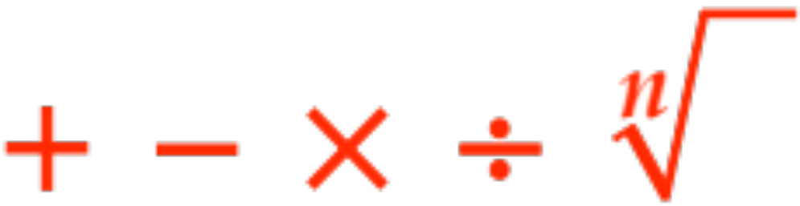
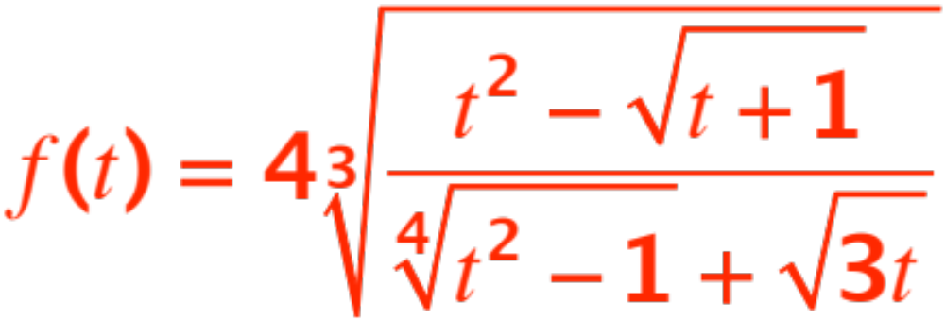
Algebraic functions. Any function obtained by repeatedly and successively applying in any order any of the following algebraic operations:
Things can get pretty wild with just these 5 simple operations! Here is an example:

Slide 11
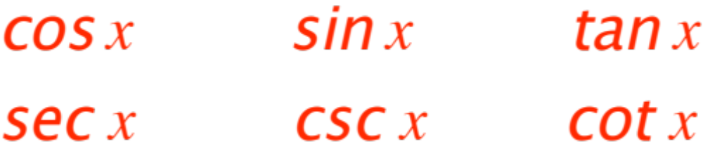
Trigonometric functions. The following six functions and algebraic combinations thereof.
As usual, once again things can get pretty wild, you write some crazy expression involving
and the above six functions! (Have some fun !)

Slide 12


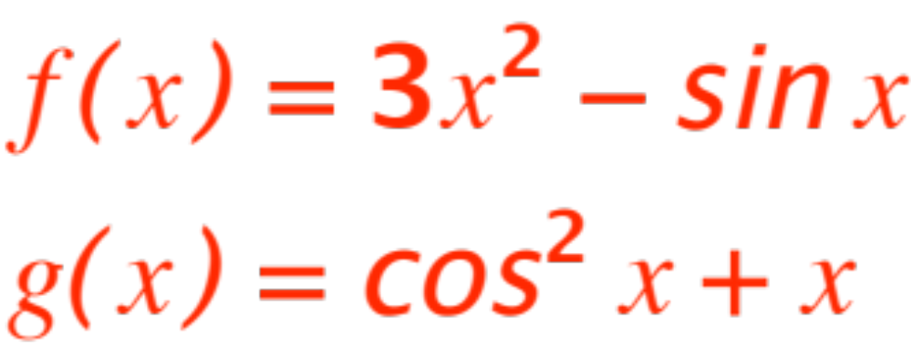
Operations on functions
As with numbers, if we are given any two functions and we can operate on them by applying the usual arithmetic operations, as in
then

Slide 13

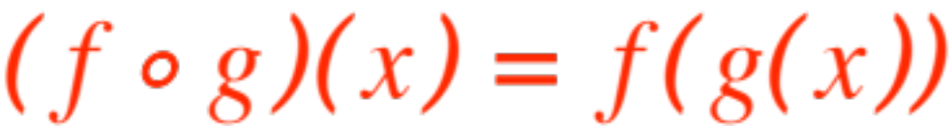
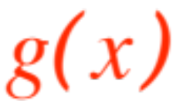


There is another operation we can perform, with very useful results.
It is called “composition”
It is denoted by
(note the little circle !)
and it is defined by
i.e., given , first compute ,
then apply the function to the result you got.

Slide 14
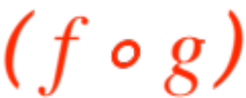
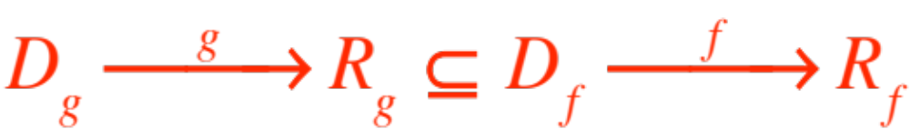
Pictorially the composition
(first then ) is represented by
This diagram makes clear that the values obtained by the first function must be part of the domain of the second function. It also makes clear that composition of functions is NOT commutative ! (Putting on socks and putting on shoes do NOT commute !)

Slide 15
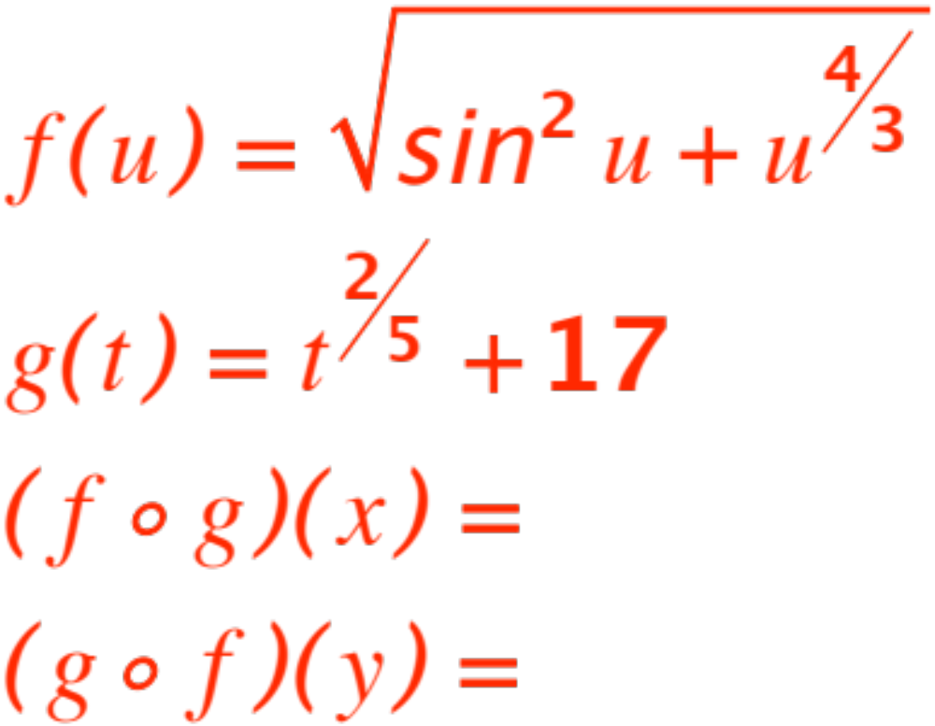
We will work out some examples on the board.
I am intentionally making this hard, for your benefit !

Slide 16
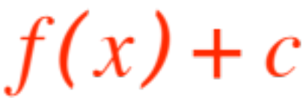

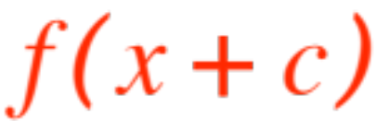
VERTICAL AND HORIZONTAL
SHIFTS AND STRETCHES
This composition operation, together with the old arithmetical ones, gives us a neat way to create new functions from old ones.
In what follows figure out first what composition we are using.
shifts the graph vertically
(up if )
shifts the graph horizontally
(left if )

Slide 17
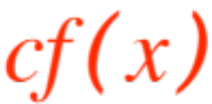


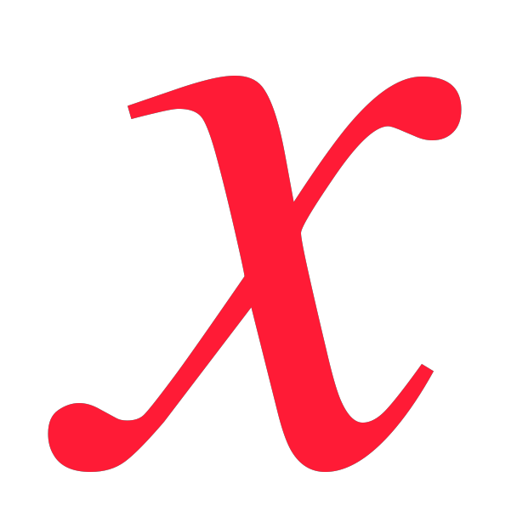
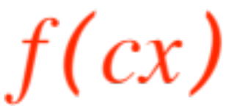

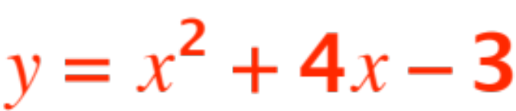
stretches the graph vertically
(enlarges if )
(Z if we reflect in first!)
stretches the graph horizontally
(compresses if )
(Z if we reflect in first!)
Example (see p. 38, example 2)
Graph

